Slide 1
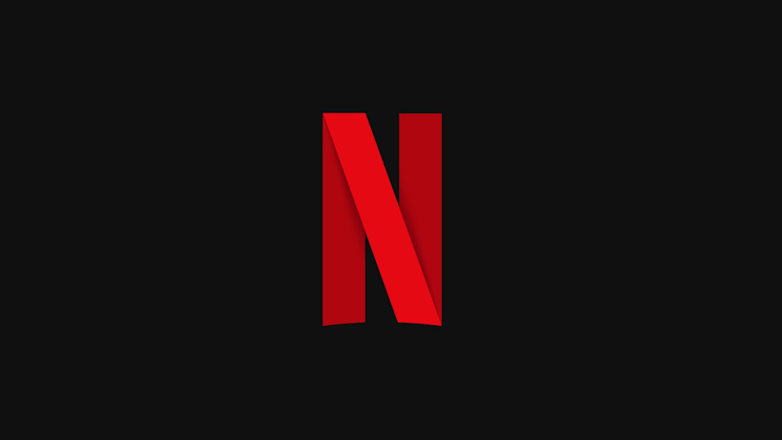

Slide 2
StreamGenie: Tailored Netflix Recommendations

Slide 3
TEAM INFORMATION
Title: StreamGenie: Tailored Netflix Recommendations
Team - 17:
Sahasra Koppal
Shreya Reddy Chidirala
Yoshitha Reddy Lingaladinne

Slide 4
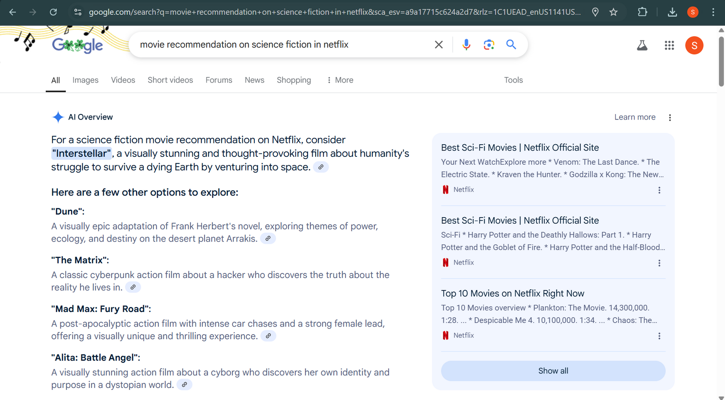
GOOGLE

Slide 5
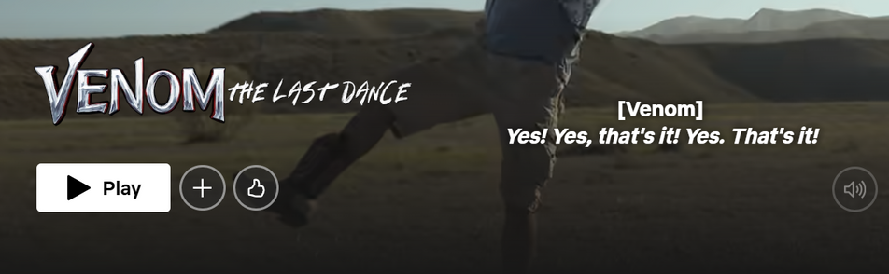
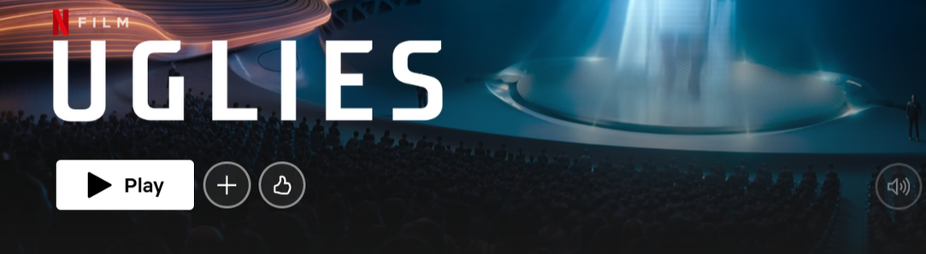
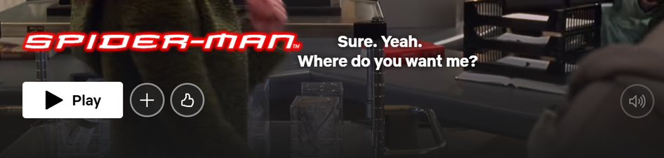
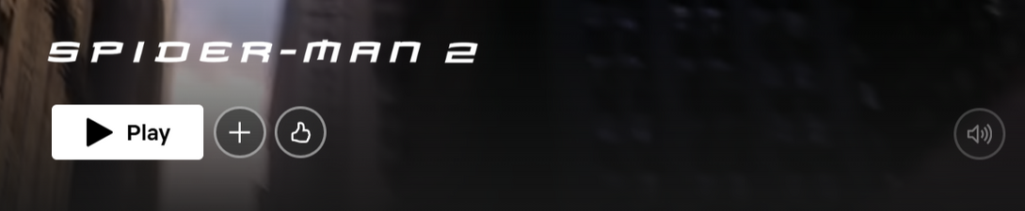
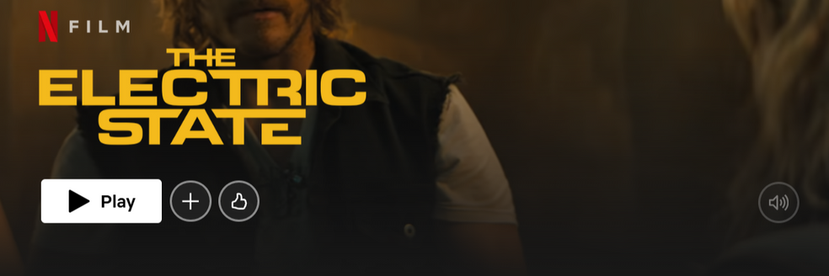
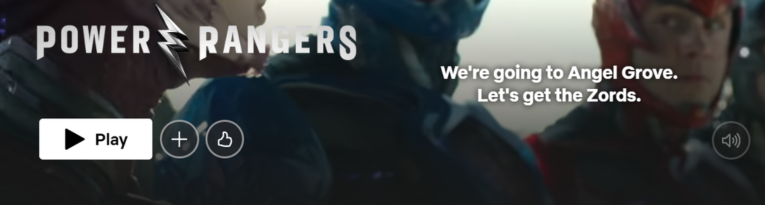
FRIEND SUGGESTION

Slide 6
MOTIVATION
With thousands of movies available, users struggle to find what to watch next.
A recommendation system enhances user experience by suggesting relevant movies.
Netflix and other platforms use AI to personalize recommendations.
This project aims to implement a simple yet effective movie recommendation system

Slide 7
INTRODUCTION
Movie recommendation systems are designed to provide personalized suggestions to users based on their viewing history, preferences, and other factors.
With an overwhelming number of options available on streaming platforms, recommendation systems help users discover relevant content efficiently.

Slide 8
OBJECTIVES
Goal
To develop a machine learning model that recommends movies to users based on their
unique tastes and preferences
Techniques
Implement collaborative filtering, content-based filtering, or hybrid approaches to
generate personalized suggestions
Optimization
Evaluate model performance using metrics like RMSE and MAE, and optimize through
hyperparameter tuning and iterative testing
Adaptability
Incorporate real-time user interactions and contextual data to refine recommendations
dynamically

Slide 9
TYPES OF RECOMMENDATION SYSTEMS
Content-Based Filtering:
Analyzes movie metadata (genres, cast, plot).
Collaborative Filtering:
Compares user preferences and interactions.
Hybrid Approach:
Combines content-based and collaborative filtering.

Slide 10
TECHNOLOGY STACK
Python:
Main programming language.
Pandas:
For handling movie datasets.
Scikit-learn:
For machine learning and similarity calculations.
Streamlit:
To build an interactive web-based interface.

Slide 11
PROPOSED SYSTEM
Accessibility
Create a public dashboard so that it can be accessed from anywhere.
Data Collection
Collect data from real-world people to gain insights.
Insights
Provide real-time trend analysis of people's preferences for watching movies on either
OTT platforms or theaters.
Recommendation
Build a model to recommend movies based on specific criteria.

Slide 12
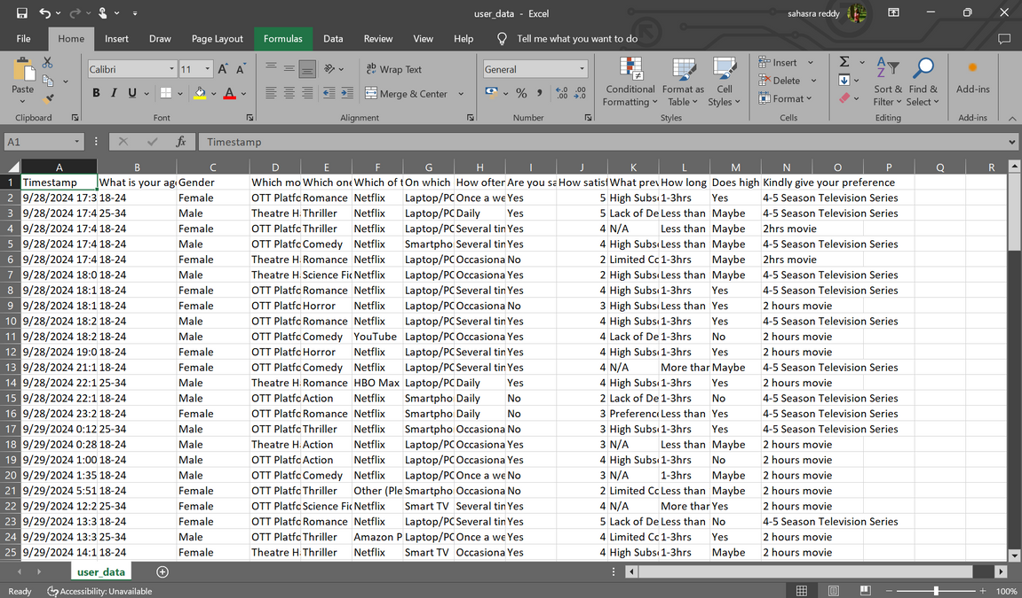
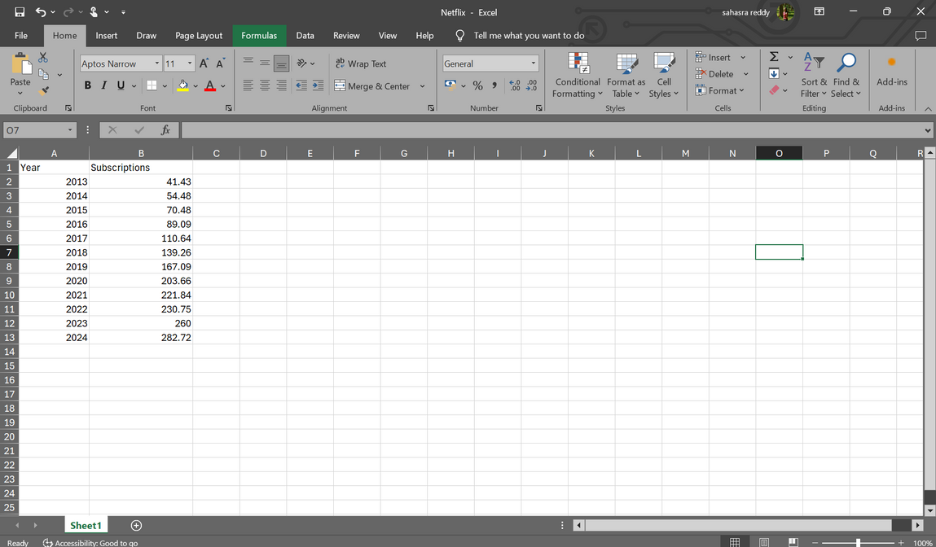
DATASETS

Slide 13
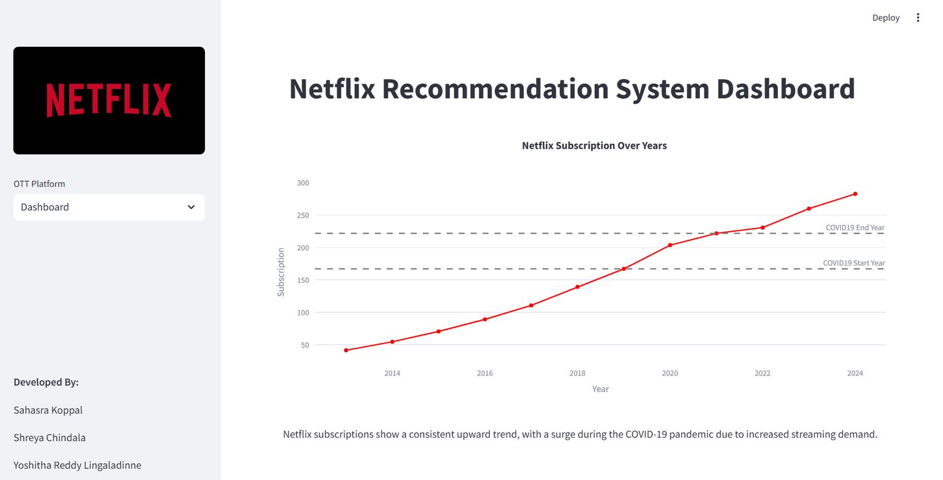
GRAPHICAL REPRESENTATION

Slide 14
MODEL-1: CONTENT BASED FILTERING
Recommends movies based on their descriptions, genres, and metadata.
Uses Natural Language Processing (NLP) to analyze movie synopses.
Identifies similarities between movies by comparing textual data.
Uses Cosine Similarity to find related movies.

Slide 15
TF-IDF
• TF-IDF (Term Frequency - Inverse Document Frequency) is used to convert text into numerical values.
• Measures the importance of words in a document while reducing the weight of commonly used words.
• Formula: TF-IDF = TF × IDF

Slide 16
MODEL 2: COLLABORATIVE FILTERING
Recommends movies based on user interactions and preferences.
Identifies users with similar tastes and suggests movies they liked.
Uses watch history and ratings to make recommendations.
Two types:
User-Based & Item-Based Collaborative Filtering.

Slide 17
COSINE SIMILARITY
• Measures similarity between two movies based on their text descriptions.
• Formula: cos(θ) = (A · B) / (||A|| * ||B||)
• The closer the value to 1, the more similar the movies are.

Slide 18
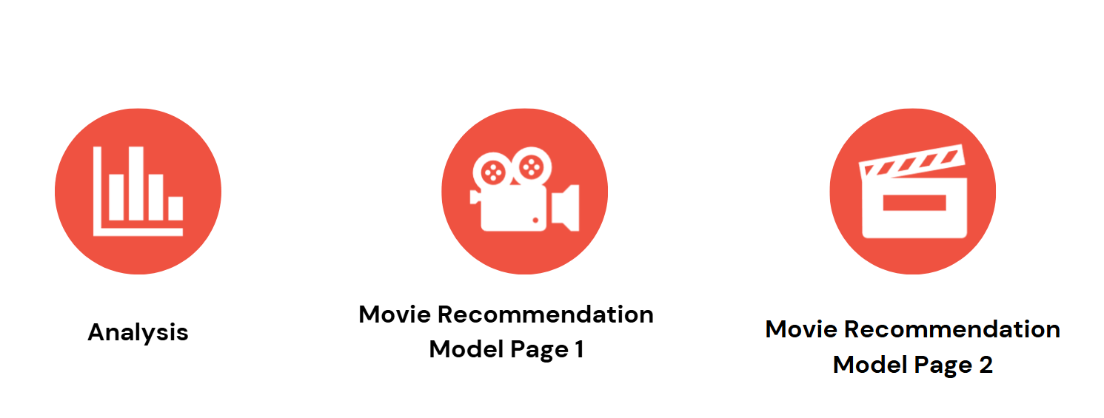
SCREENS

Slide 19
CONCLUSION & FUTURE SCOPE
Netflix Recommendation System is built using TF-IDF and Cosine Similarity.
Streamlit provides an easy-to-use web interface for real-time recommendations. Can be extended with Hybrid Models for better accuracy and real-world application.
With more data, we unlock deeper insights and extract valuable information from real-world datasets.
Utilize cutting-edge AI concepts like Large Memory Models (LMM) and Large Language Models (LLM) to deliver diverse, personalized recommendations.

Slide 20


